Slide 1

Benchmarking of Machine Learning and Deep Learning approaches for Neuroimaging Data
Team CogniNet: Antipushina E., Knyshenko M., Kalimullin R., Morozova M.
Mentors: Petr Mokrov, Maria Zubrikhina
Course instructors: Evgeny Burnaev, Alexey Zaytsev
Machine Learning course. Term 3. 2023

Slide 2
Outline
Theory
Relevance of the task: problem statement and project goals
Data description (fMRI, Connectivity matrices and ROIs)
Practical part
Classical Machine Learning algorithms
Deep Learning approaches

Slide 3
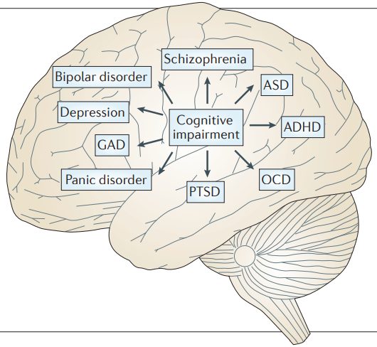




Relevance of the task
Problem statement:
At the moment, there is no clear understanding which methods will work best for fMRI data.
Problem with publication results
Globally: problem of identifying biomarkers isn’t solved.
Project goals:
Implement classic ML algorithms and fix the metrics.
Compare with at least one graph approach.
Relevant papers
Notes:
1 there is no clear understanding of which methods to use
2 results of articles show high results on metrics but when reproduced it turns out not so
3 the problem of searching for biomarkers has not been solved
goals
1 apply ml approaches and fix metrics
2 compare results with at least one graph algorithm
As a result of determining the most appropriate method for solving this problem, it will be possible to determine biomarkers of cognitive diseases on fMRI.

Slide 4
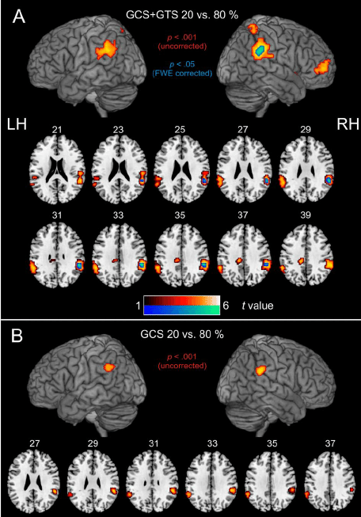
About fMRI
Functional magnetic resonance imaging (fMRI) measures the small changes in blood flow that occur with brain activity.
It may be used to examine which parts of the brain are handling critical functions, evaluate the effects of stroke or other disease, or to guide brain treatment.

Slide 5
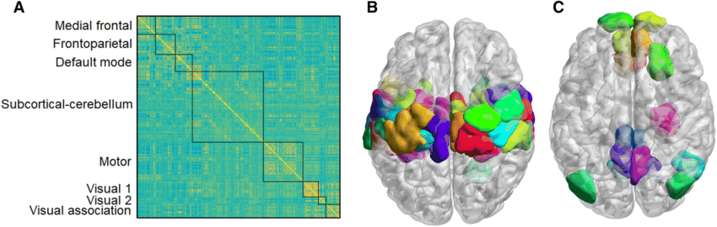
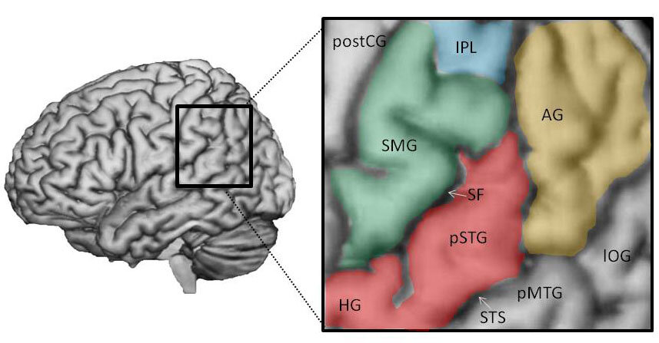
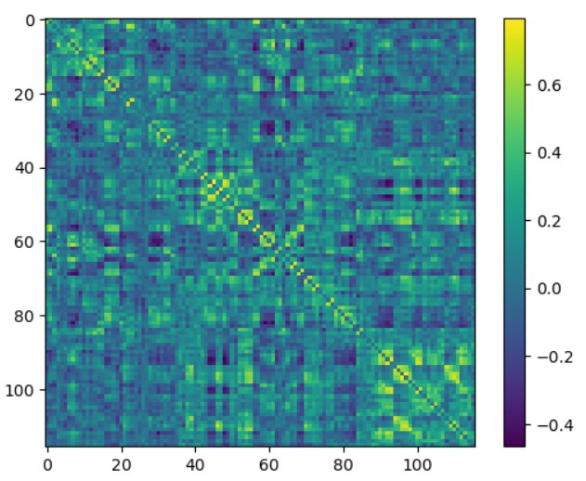
Datasets description
Functional connectivity (FC) is denoted as a matrix with the rows and columns representing nodes and each element of the matrix representing the edge strength or functional connection between the corresponding nodes.
COBRE Dataset+AAL labeling: 163 connectivity matrices (116x116), 79 patients with schizophrenia and 73 healthy controls
ABIDE Dataset+Craddock labeling: 1035 connectivity matrices (200x200), 530 with Autism spectrum disorder (ASD) and 505 healthy controls.
Figure 1 - Brain network-related regions of interest (ROIs)
Lee YB, Yoo K, Roh JH, Moon WJ, Jeong Y. Brain-State Extraction Algorithm Based on the State Transition (BEST): A Dynamic Functional Brain Network Analysis in fMRI Study. Brain Topogr. 2019 Sep;32(5):897-913. doi: 10.1007/s10548-019-00719-7. Epub 2019 Jun 3. PMID: 31161473.

Slide 6
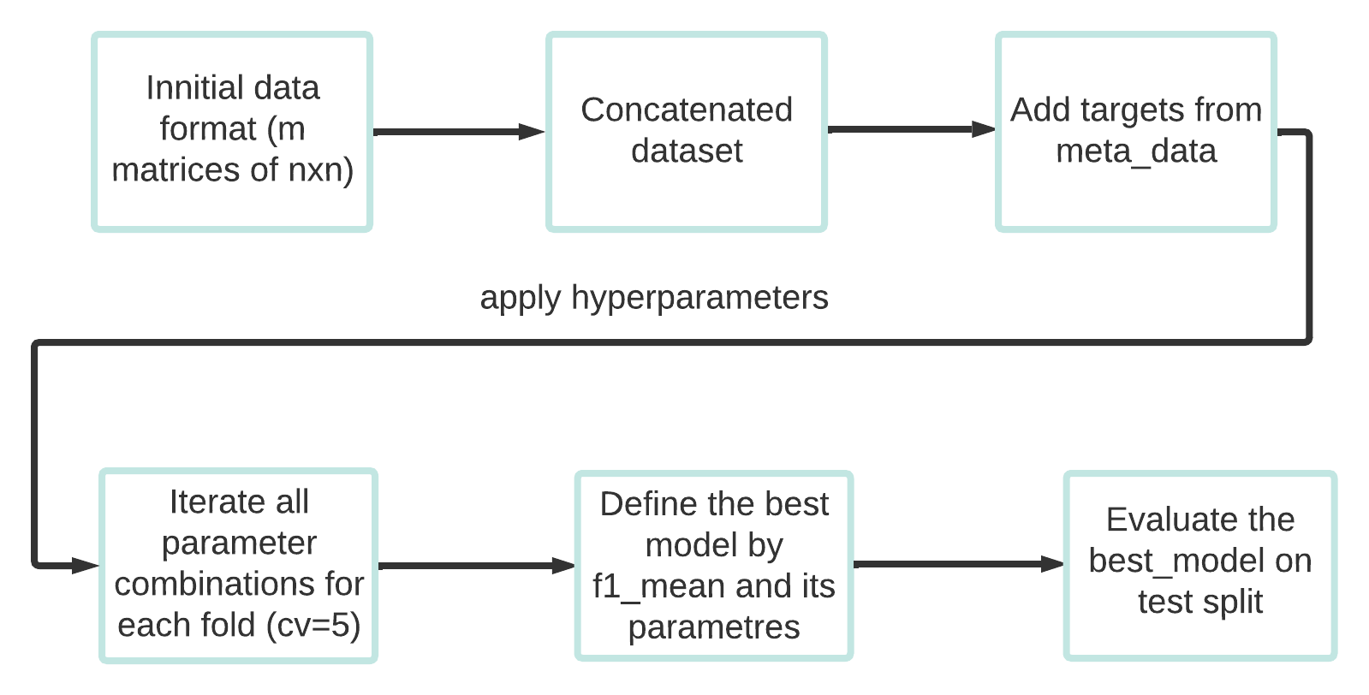
Classical Machine learning approach
Considered models: Logistic Regression; Random Forest; SVM; SVM + PCA; XGBoost.
Figure 2 - Code logic block diagram

Slide 7
Classical ML results for COBRE dataset
 | F1 score | Accuracy | ROC-AUC
Logistic Regression | 0.73 ± 0.056 | 0.76 ± 0.045 | 0.76 ± 0.049
Random Forest | 0.65 ± 0.073 | 0.69 ± 0.064 | 0.69 ± 0.065
SVM | 0.76 ± 0.058 | 0.78 ± 0.039 | 0.79 ± 0.047
SVM + PCA | 0.71 ± 0.099 | 0.76 ± 0.062 | 0.75 ± 0.072
XGBoost | 0.67 ± 0.044 | 0.72 ± 0.029 | 0.71 ± 0.033
Best hyperparameters
'class_weight': None, 'penalty': 'l2', 'C': 0.1, 'solver': 'liblinear'
n_estimators': 50, 'max_depth': 3
'C': 0.01, 'kernel': 'linear','probability': True
'C': 10, 'kernel': 'linear','class_weight': 'balanced', 'probability': True, n_components=70
'objective': 'binary:logistic', 'eta': 0.1, 'max_depth': 10, 'scale_pos_weight': 1.0, 'alpha': 0

Slide 8
Classical ML results for ABIDE dataset
 | F1 score | Accuracy | ROC-AUC
Logistic Regression | 0.66 ± 0.013 | 0.65 ± 0.012 | 0.66 ± 0.013
Random Forest | 0.65 ± 0.037 | 0.67 ± 0.030 | 0.67 ± 0.031
SVM | 0.67 ± 0.012 | 0.67 ± 0.013 | 0.67 ± 0.013
SVM + PCA | 0.69 ± 0.017 | 0.68 ± 0.015 | 0.68 ± 0.016
XGBoost | 0.65 ± 0.007 | 0.63 ± 0.010 | 0.63 ± 0.011
Best hyperparameters
'class_weight': None, 'penalty': 'l2', 'C': 10
n_estimators': 100, 'max_depth': 3
'C': 10, 'kernel': 'rbfr'
'C': 0.01, 'kernel': 'linear','class_weight': 'balanced', 'probability': True, n_components = 500
'max_depth': 10, 'scale_pos_weight': 1.0, 'alpha': 0

Slide 9
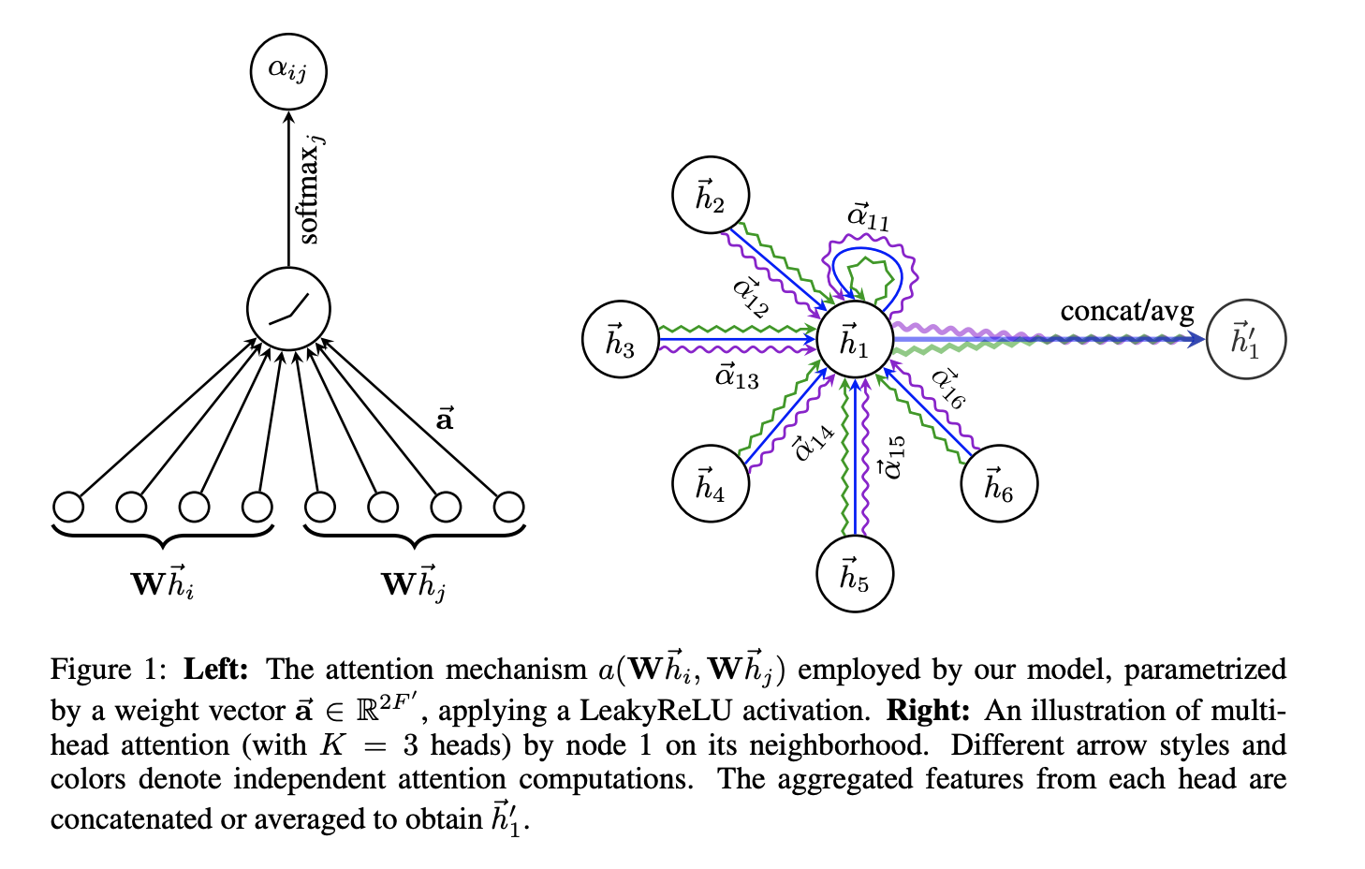
Graph-Attention Neural Network
Figure 3 - GAT architecture
https://arxiv.org/abs/1710.10903v3

Slide 10
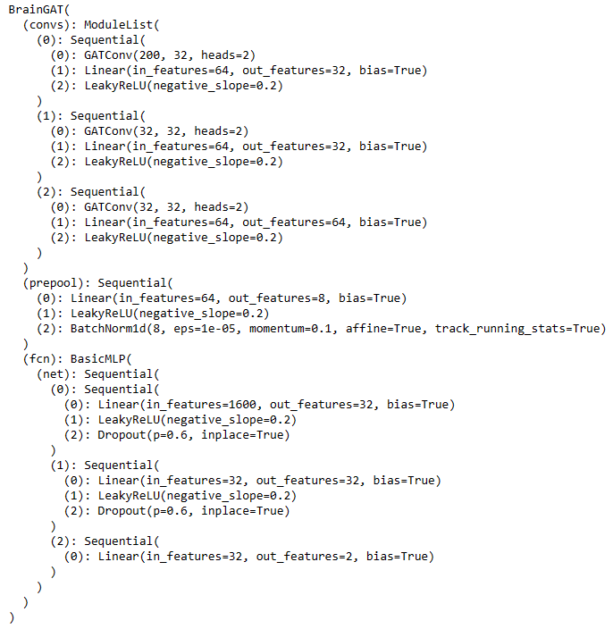
Deep Learning approach. Graph Neural Networks
}
torch_geometric.nn.conv.GATConv
graph attentional operator
}
fully connected layers (fcn)
number of GATConv layers
number of neurons in GATConv
GATConv parameters (heads)
fcn parameters (number of neurons, layers)
regularizations (BatchNorm, Dropout)

Slide 11
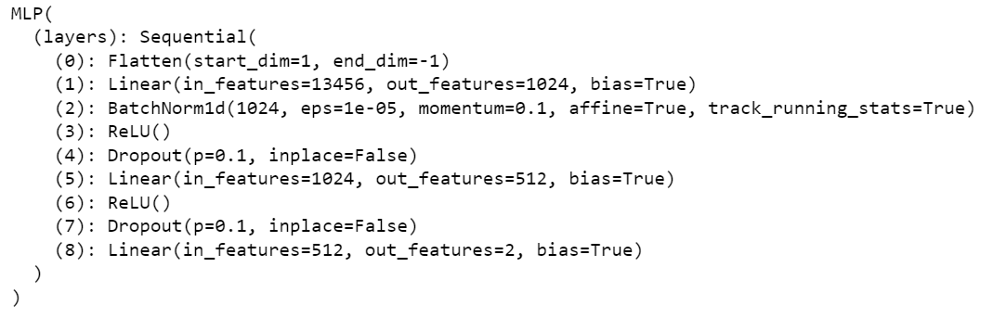
Deep Learning approach. Baseline: multilayer perceptron
number of neurons
number of layers
regularizations

Slide 12
Training
Classic AdamW, lr=0.001, 60 epochs for training
After each epoch, F1 Score, Accuracy, ROC-AUC are estimated on the test set NB: train test split is the same as in classical ML
Best F1 Score, Accuracy, ROC-AUC combination is saved
Repeat NN initialization and training as above 10 times to estimate variation of metrics

Slide 13
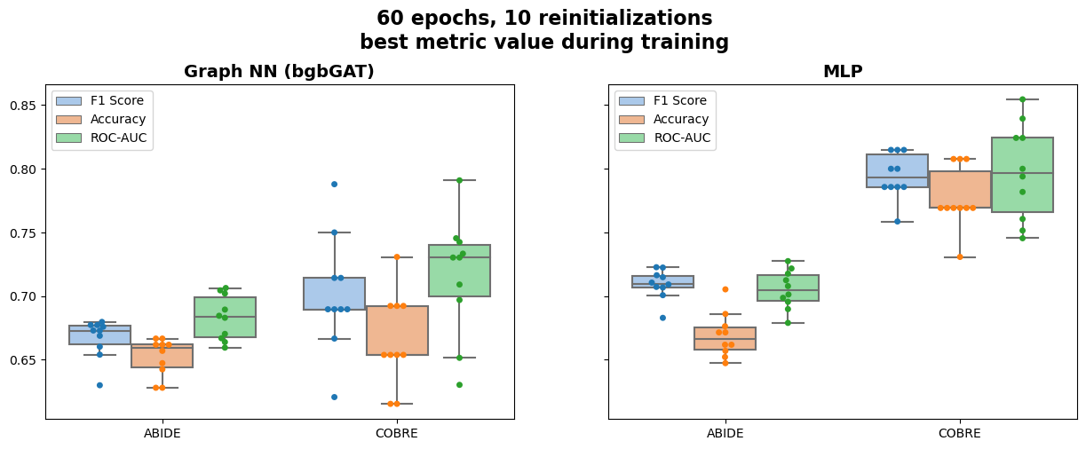
Results

Slide 14
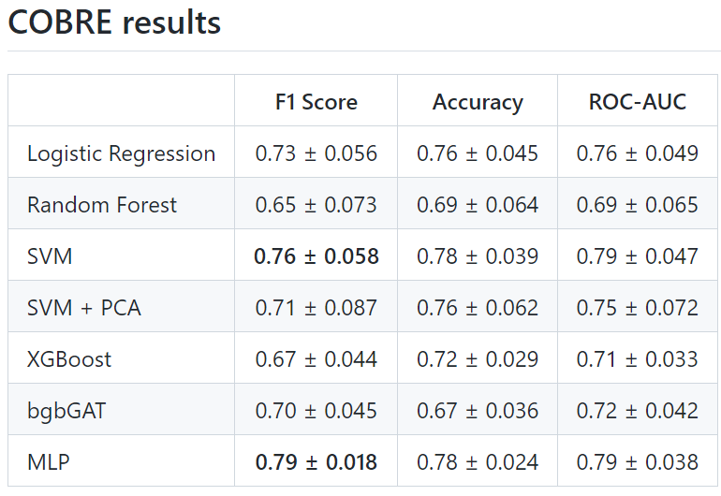
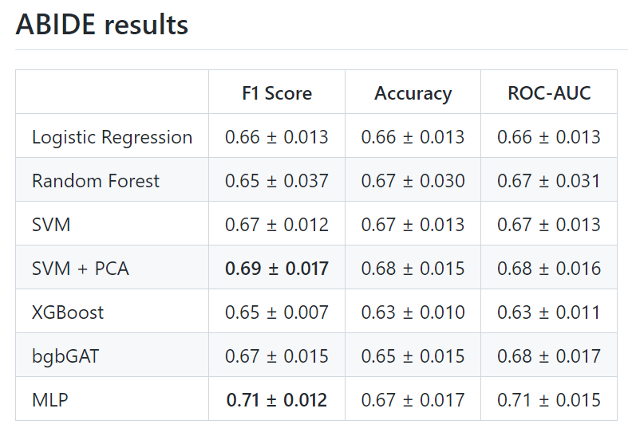
Comparison of Classic ML and DL

Slide 15
Conclusions
Usually, we do not have “Big Data” in biomedical research
Classic ML approaches are very applicable to biomedical data
Well advertised Graph-Attention Neural Networks may not give the best result in biomed
For our comparatively small medical datasets, old classic Multilayer Perceptron and SVM beats all the other models

Slide 16
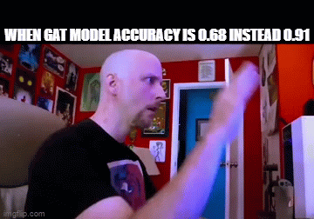

thx!
Link to our github:
https://github.com/utoprey/CogniNet

Slide 17

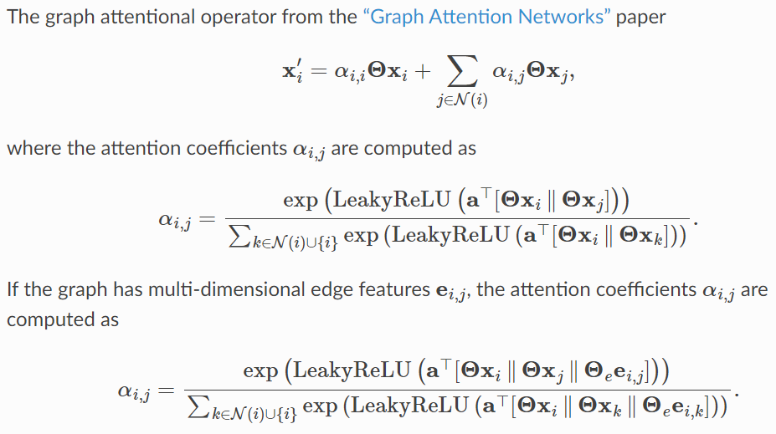
GATConv

